Slide 1

The rise of Ransomware
J.A.D.S.K Nanayakkara
it21119194

Slide 2
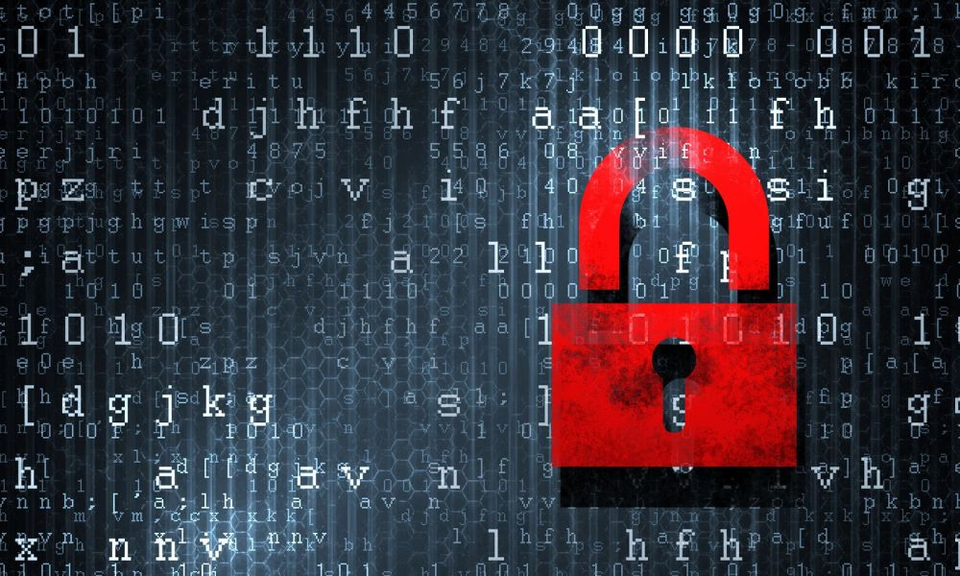
Table of Contents
Introduction
Evolution of ransomware
Types of Ransomware
Damage cost of ransomware
Prevent ransomware attack
future developments in the area
Conclusion
This Photo by Unknown Author is licensed under CC BY-NC

Slide 3
Introduction
Ransomware is a type of malicious software (malware) that threatens to publish or blocks access to data or a computer system, usually by encrypting it, until the victim pays a ransom fee to the attacker. In many cases, the ransom demand comes with a deadline. If the victim doesn’t pay in time, the data is gone forever or the ransom increases.
Ransomware attacks are all too common these days. Major companies in North America and Europe alike have fallen victim to it. Cybercriminals will attack any consumer or any business and victims come from all industries.

Slide 4
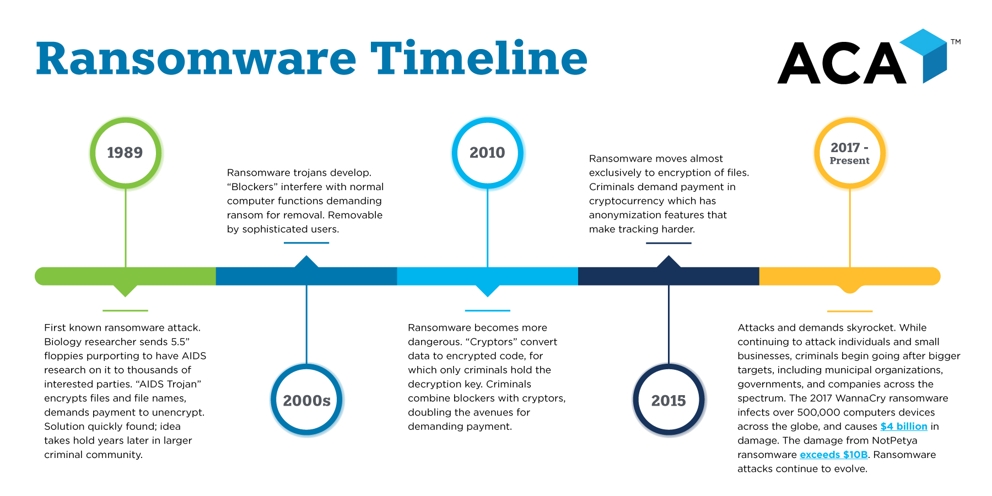

Slide 5

Type of ransomware
Crypto Ransomware
Locker Ransomware
Scareware
Ransomware as a serviced (RaaS)

Slide 6
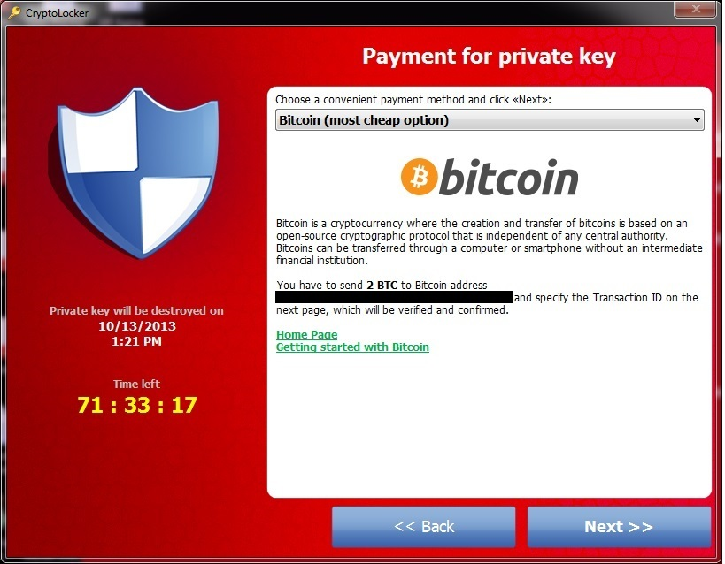
Crypto ransomware
The aim of crypto ransomware is to encrypt your important data, such as documents, pictures and videos, but not to interfere with basic computer functions.
This spreads panic because users can see their files but cannot access them. Crypto developers often add a countdown to their ransom demand: "If you don't pay the ransom by the deadline, all your files will be deleted." and due to the number of users who are unaware of the need for backups in the cloud or on external physical storage devices, crypto ransomware can have a devastating impact.
Consequently, many victims pay the ransom simply to get their files back

Slide 7
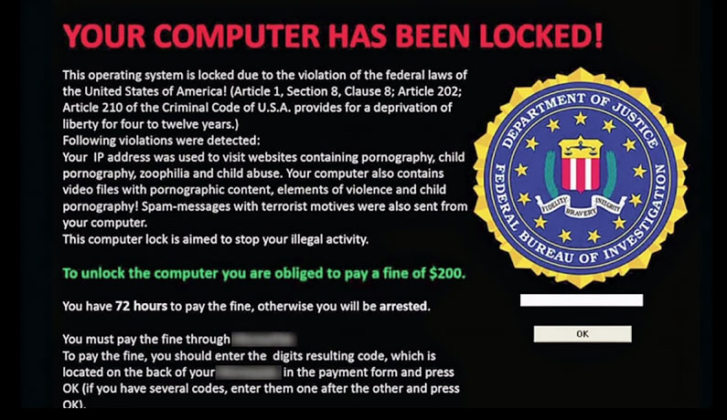
Locker ransomware
This type of malware blocks basic computer functions. For example, you may be denied access to the desktop, while the mouse and keyboard are partially disabled.
This allows you to continue to interact with the window containing the ransom demand in order to make the payment. Apart from that, the computer is inoperable.
But there is good news: Locker malware doesn't usually target critical files; it generally just wants to lock you out. Complete destruction of your data is therefore unlikely.

Slide 8
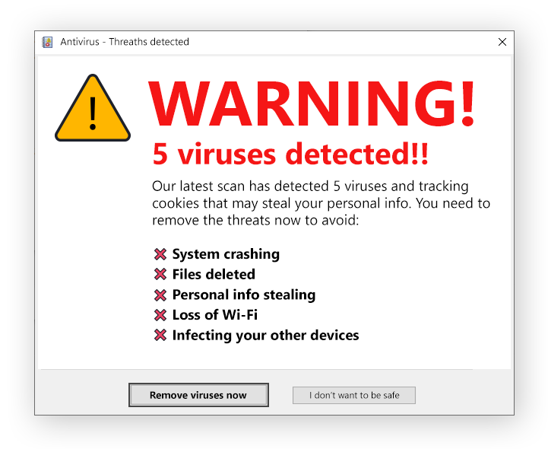
Scareware
Scareware is a malware tactic that manipulates users into believing they need to download or buy malicious, sometimes useless, software. Most often initiated using a pop-up ad, scareware uses social engineering to take advantage of a user’s fear, coaxing them into installing fake anti-virus software.
Scareware goals can vary from selling useless, fake tools to the installation of damaging malware that exposes sensitive data.
Scareware has been known to convince users to download ransomware, a form of malware that holds the user’s data hostage in exchange for a payout.

Slide 9
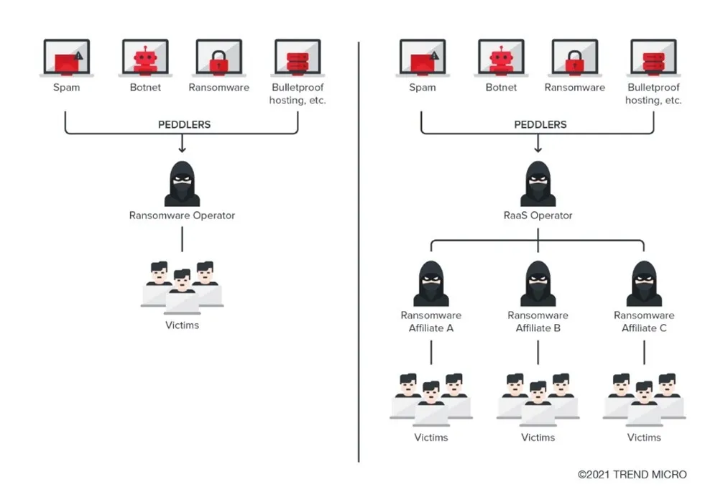
Ransomware as a service
Ransomware as a Service (RaaS) is a business model between ransomware operators and affiliates in which affiliates pay to launch ransomware attacks developed by operators. Think of ransomware as a service as a variation of software as a service (SaaS) business model.

Slide 10
Ransomware attacks
Kaseya (2021)
JBS (2021)
Colonial Pipeline (2021)
CWT (2020)

Slide 11
Kaseya (2021)
JBS (2021)
REvil launched a ransomware attack, demanding payment of $70 million from Kaseya. The company provides IT infrastructure management solutions for Managed Service Providers (MSPs) and internal IT organizations and serves customers worldwide.
This attack is one of the latest incidents the US government is trying to eradicate, but concern extends far beyond the US border since as many as 1,500 companies worldwide may be affected.
JBS USA, one of the largest meat suppliers in the United States, disclosed a cyberattack that forced it to temporarily shut down five of its primary US-based plants. The company's operations in Australia and the United Kingdom were also affected by the ransomware attack.
JBS paid the hackers an $11 million ransom in Bitcoin to avert further disruption and to limit the damage to grocery stores and restaurants. The FBI attributed the infiltration to REvil, a sophisticated criminal cell known for ransomware attacks.

Slide 12
Colonial Pipeline (2021)
CWT (2020)
Colonial Pipeline, an American oil pipeline system that originates in Houston, Texas, and carries gasoline and jet fuel mainly to the Southeastern United States, suffered a ransomware cyberattack that impacted computerized equipment managing the pipeline. The Colonial Pipeline Company halted all pipeline operations to contain the attack.
the Department of Justice announced that it had recovered 63.7 of the bitcoins (approximately $2.3 million) from the ransom payment.
CWT, a US corporate travel management business, said on July 31, 2020, that its systems had been hacked by ransomware and that it had paid the ransom. Using Ragnar Locker ransomware, the attackers claimed to have stolen sensitive corporate data and shut down 30,000 company computers.
As a consequence, the company paid the hackers $4.5 million on July 28, only days before Reuters reported the story

Slide 13
Prevent ransomware attacks
Education, Training, and Measurement
Back-up data
Use protection software and Always update OS
Remove Administrator Rights

Slide 14
Future developments in the area

Slide 15
Conclusion
Ransomware attacks are a growing threat that have dealt significant damage in the past.
It is mandatory to take immediate action against these ransomware attacks

